Slide 1
AUGMENTED VISUAL INTELLIGENCE
TEAM MEMBERS: SUBMITTED TO:
MUDIT BHATTA (20BCE2888) PROF. DR. SWARNALATHA P
SANDESH KHATIWADA (20BCE2898)
SARJAK DEVKOTA (20BCE2922)
SIDDHANT KARKI (20BCE2936)

Slide 2
INTRODUCTION
The Augmented Visual Intelligence initiative attempts to make learning simple for students who are blind. The project consists of a web-app that visually challenged students may use to play games, take tests, read material aloud, and other things while navigating the web-app.
They can use the search bar or voice commands to navigate this webapp. Since the advent of the internet, information has become increasingly important and must be accessible to everyone, including those who are blind or visually impaired. Through the use of technologies like speech recognition, websites may be easily accessed by those who are visually impaired. They might supply an audio input and can obtain the necessary result via speech output, making it simple for them to navigate the website. People who are visually handicapped can use voice input to engage with the website thanks to this sort of strategy. Voice output will make it easier to read the website's content and navigate between links, addressing the accessibility issue for people with visual impairments.

Slide 3
Motivation
The Augmented Vision Learning initiative aims to make learning more accessible to visually impaired students. It comprises a web application that allows users to play games, take exams with voice help, read information aloud, and use voice commands to navigate the program. With the prototype in place, we can add new features such as voice-assisted to-do lists, news and weather updates, and more. In the future, we hope to study the possibility of voice-activated games and multilingual support. Our ultimate objective is to make our product widely available to special schools for pupils who are visually impaired. This will make the learning process easier for both students and teachers since they will have access to a user friendly platform that is tailored to their individual needs. The sample website we built contains capabilities like object detection, text-to-speech recognition, and voice aid when surfing, making it easier for visually impaired pupils to connect with the internet. Most websites are inaccessible to people with visual impairments, but our website seeks to lower the technological barriers that keep them from interacting with technology. We seek to expand visually impaired people’s access to information and knowledge by empowering them and encouraging their digital literacy. Our design has the ability to expand over time, including increasingly modern technology and features to increase internet accessibility for the blind.

Slide 4
PROBLEM STATEMENT
Today, a lot of people rely on the internet to broaden their knowledge and learn new things. The digital revolution has not had an equal impact on everyone. Unfortunately, persons with visual impairments who have problems utilising the internet are still not able to get benefit from this useful tool. Technology has made life simpler for everyone, including blind people. Smartphones and tablets have altered the interaction and usage of technology by blind or visually impaired people.
However, they are still unable to see what is there and interact with it effectively when utilising a specific piece of technology, such as browsing a web page. Most visually impaired persons have some degree of vision impairment, and available assistive equipment is expensive. The majority of blind users cannot afford to install specialised reading aids like screen reader access because it is difficult and expensive to do so. A website that is simple to use and navigate for persons who are blind or visually impaired must be made with all these factors in mind. Technology like voice recognition is needed for this.

Slide 5
SCOPE
For visually impaired students, the Assisted Vision Learning project includes a web application that lets users play games, take voice-assisted tests, read material aloud, and navigate the application with voice commands.
We may add other capabilities, such as voice-assisted to-do lists, news and weather updates, etc., based on the prototype. If our concept is further investigated, we can incorporate voice-activated games, many languages, etc.
After our product has undergone significant growth, it may eventually be employed at special schools for kids who are blind or visually impaired, making learning simpler for both the students and teachers at these schools.

Slide 6
CHALLENGES
Notwithstanding the potential benefits of the Assisted Vision Learning initiative, a number of obstacles must be overcome in order for it to be a success. The online application will take large resources to develop and operate, and securing funding for these efforts may be difficult. The integration of voice recognition and text-to-speech technologies with the web application necessitates a high degree of technical skill, and it may be challenging to locate the proper people to design and maintain the program. The online application will only be successful if visually challenged students use it widely. The application’s usability and accessibility will be key to its success. Several web tools and technologies are available for visually impaired pupils, and user competitiveness may be a challenge. The online application must be compatible with currently available technology for visually challenged pupils, such as screen readers and Braille displays.

Slide 7
NOVELTY
Developing a novel algorithm that combines deep learning and computer vision techniques to achieve higher accuracy in object recognition tasks, even in complex and dynamic environments.
Creating a framework for integrating human expertise into machine learning models, enabling more precise and reliable visual analysis in specialized fields such as medical diagnosis, where human knowledge is critical.
Designing a user-friendly interface that allows non-experts to interact with the AI system and provide feedback, facilitating more effective and efficient learning and adaptation of the model over time.

Slide 8
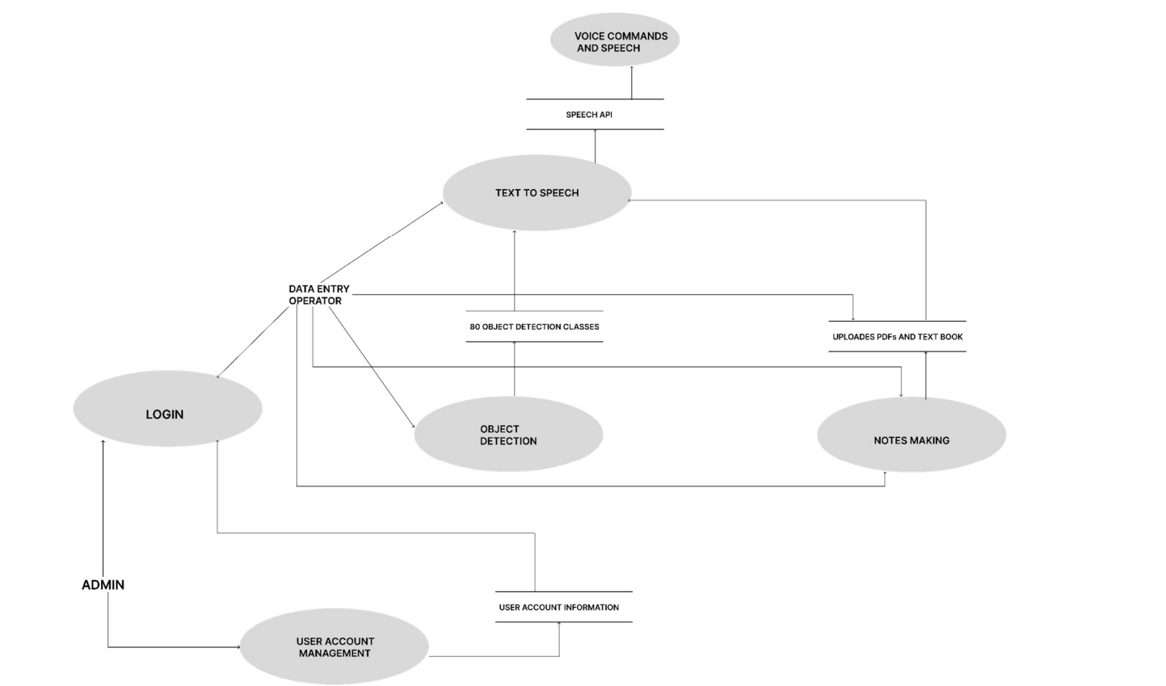
FLOW DIAGRAM

Slide 9
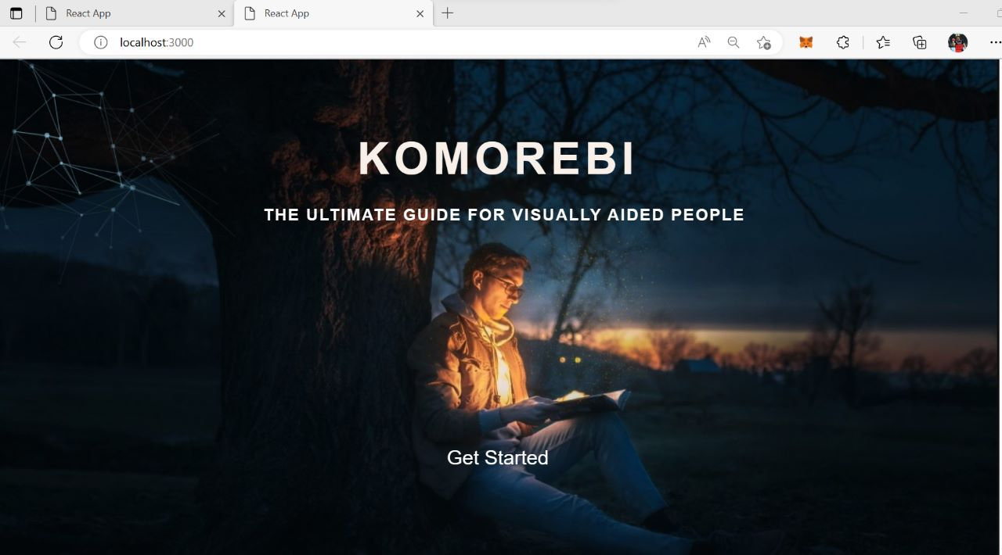

Slide 10
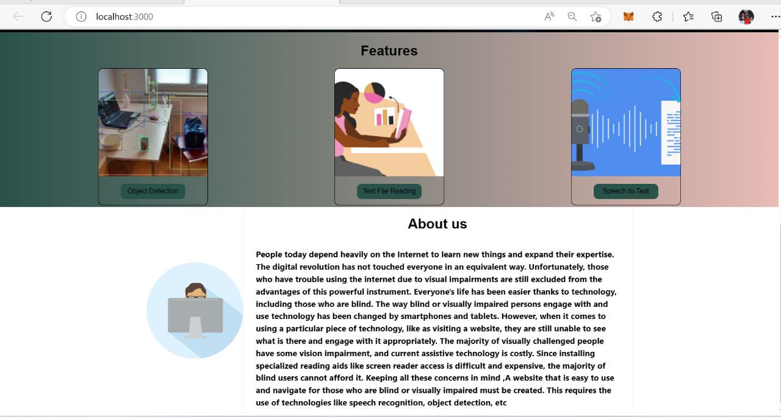

Slide 11
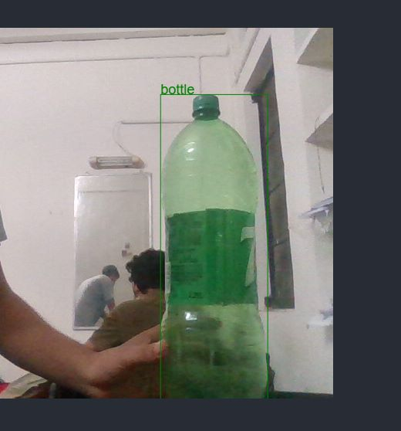
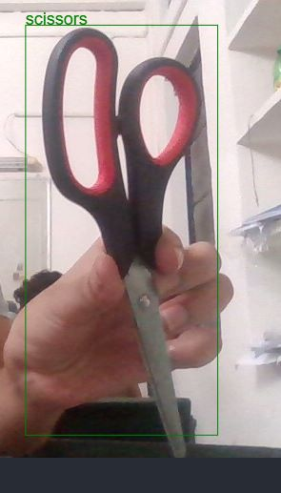
The above images shows the difference between different things

Slide 12
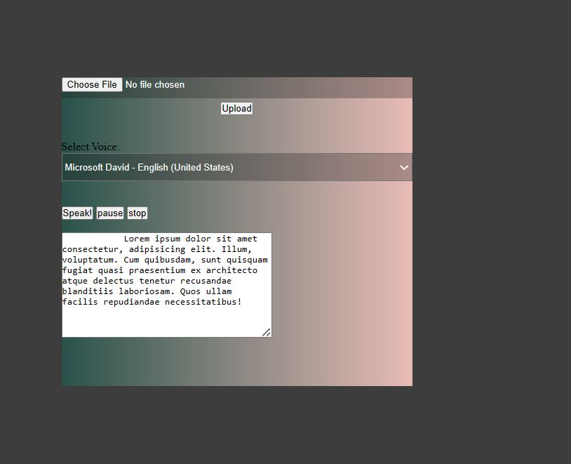

Slide 13
REFERENCE
"OBJECT DETECTION WITH DISCRIMINATIVELY TRAINED PART-BASED MODELS" BY P. F. FELZENSZWALB, R. B. GIRSHICK, D. MCALLESTER, AND D. RAMANAN, PUBLISHED IN IEEE TRANSACTIONS ON PATTERN ANALYSIS AND MACHINE INTELLIGENCE IN 2010. THIS PAPER PRESENTS A PART-BASED OBJECT DETECTION METHOD THAT USES A DISCRIMINATIVE LEARNING ALGORITHM TO LEARN PARTS AND THEIR SPATIAL RELATIONSHIPS.
LINK: HTTPS://IEEEXPLORE.IEEE.ORG/DOCUMENT/5459183
"DEEP RESIDUAL LEARNING FOR IMAGE RECOGNITION" BY K. HE, X. ZHANG, S. REN, AND J. SUN, PUBLISHED IN PROCEEDINGS OF THE IEEE CONFERENCE ON COMPUTER VISION AND PATTERN RECOGNITION IN 2016. THIS PAPER INTRODUCES THE RESIDUAL LEARNING FRAMEWORK FOR DEEP NEURAL NETWORKS, WHICH SIGNIFICANTLY IMPROVES THE ACCURACY OF IMAGE RECOGNITION TASKS.
LINK: HTTPS://IEEEXPLORE.IEEE.ORG/DOCUMENT/7780459
"REAL-TIME SEMANTIC SEGMENTATION WITH FAST ATTENTION" BY J. ZHANG, R. BENENSON, AND B. SCHIELE, PUBLISHED IN PROCEEDINGS OF THE IEEE CONFERENCE ON COMPUTER VISION AND PATTERN RECOGNITION IN 2018. THIS PAPER PROPOSES A REAL-TIME SEMANTIC SEGMENTATION METHOD THAT USES A FAST ATTENTION MECHANISM TO SELECTIVELY PROCESS IMAGE REGIONS.
LINK: HTTPS://IEEEXPLORE.IEEE.ORG/DOCUMENT/8578600
"ATTENTION IS ALL YOU NEED" BY A. VASWANI, N. SHAZEER, N. PARMAR, J. USZKOREIT, L. JONES, A. N. GOMEZ, L. KAISER, AND I. POLOSUKHIN, PUBLISHED IN PROCEEDINGS OF THE ADVANCES IN NEURAL INFORMATION PROCESSING SYSTEMS CONFERENCE IN 2017. THIS PAPER PRESENTS THE TRANSFORMER ARCHITECTURE, A NEURAL NETWORK MODEL THAT USES SELF-ATTENTION MECHANISMS TO PROCESS INPUT SEQUENCES AND ACHIEVE STATE-OF-THE-ART RESULTS IN NATURAL LANGUAGE PROCESSING TASKS.

